Slide 1
Bayesian Neural Networks
Oscar Llorente Gonzalez - Senior Data Scientist
Ericsson Cognitive Labs – Geometric Artificial Intelligence (GAI) Lab
September 2025

Slide 2

Who we are
https://ericsson.github.io/cognitive-labs/

Slide 3
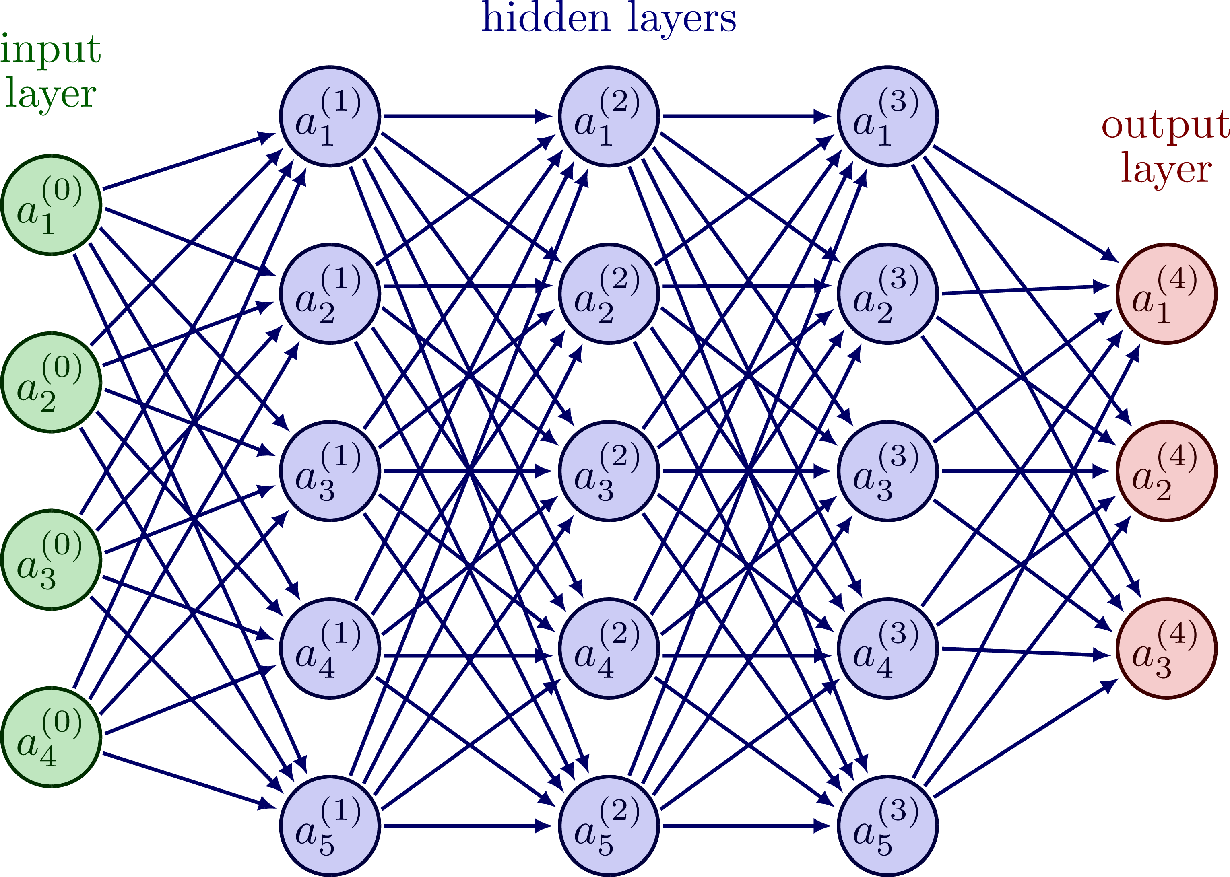
Classical Neural Networks

Slide 4
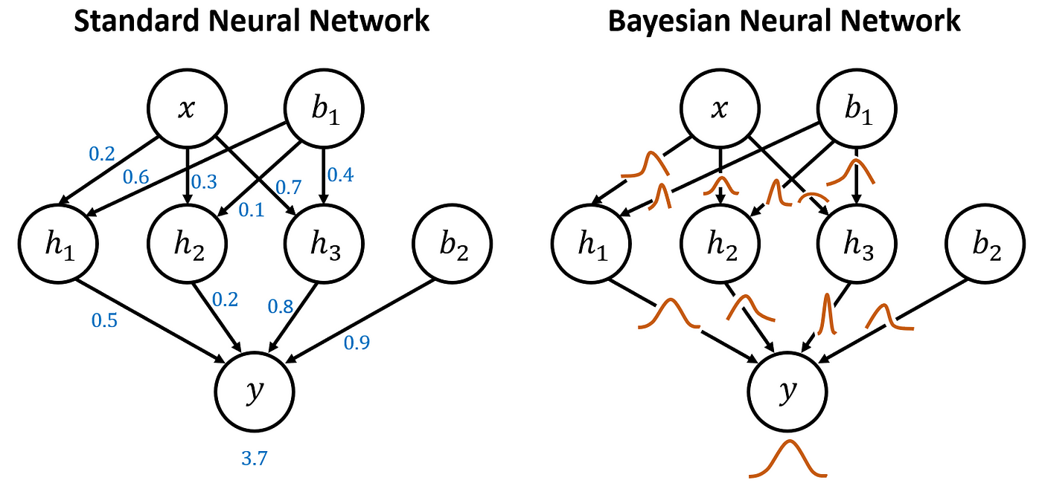
NN vs BNN

Slide 5
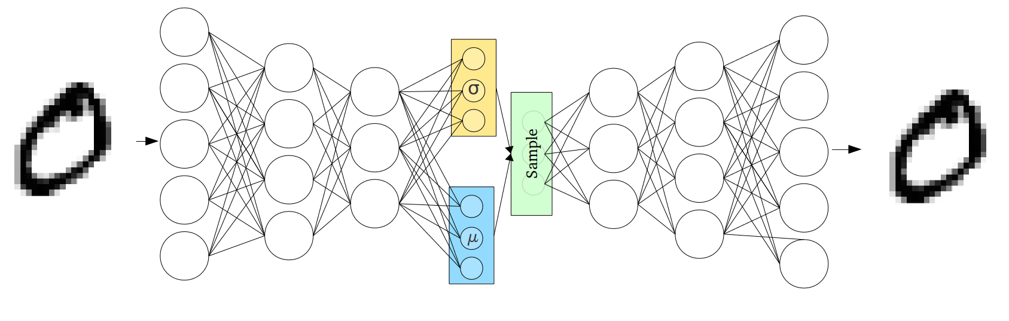

Slide 6
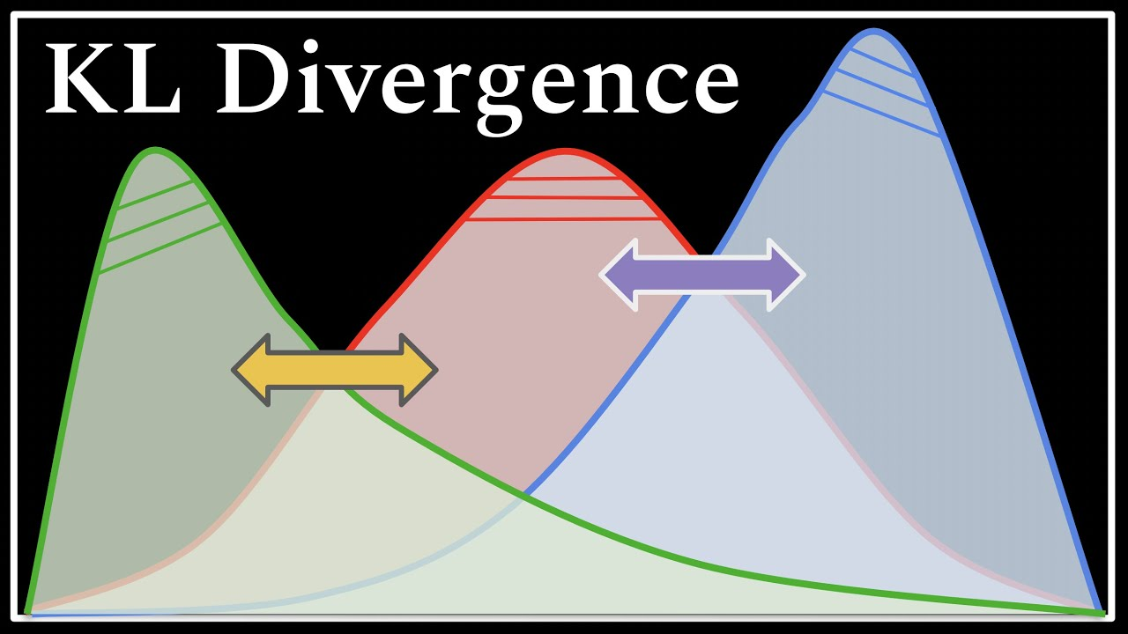
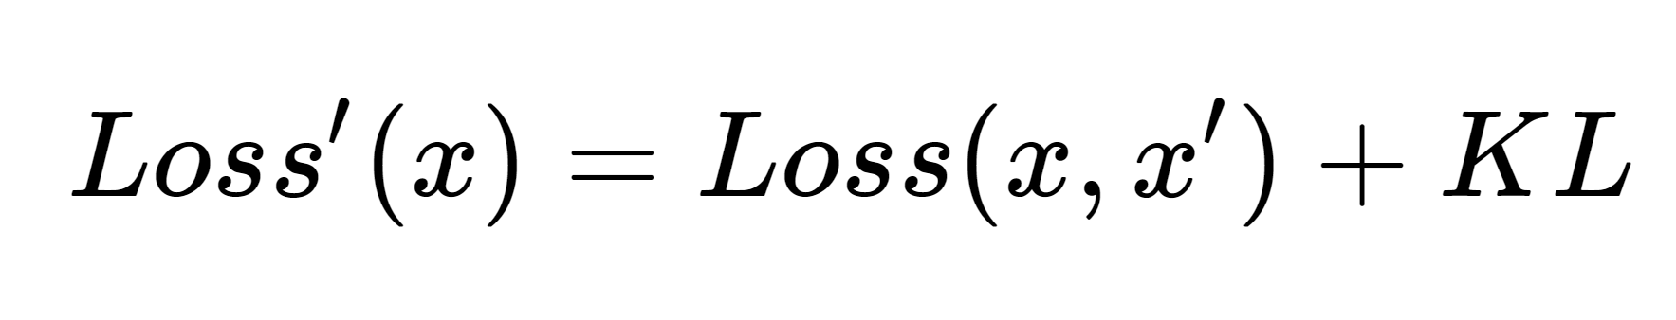
How to ensure the shape of the distributions?

Slide 7
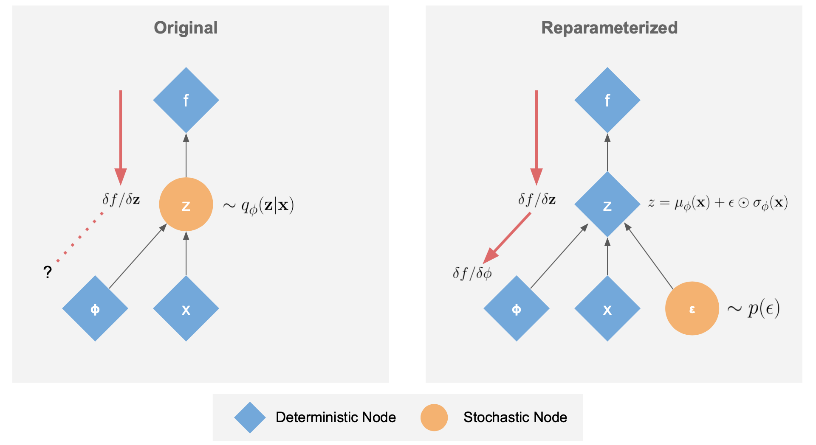
Reparameterization trick

Slide 8
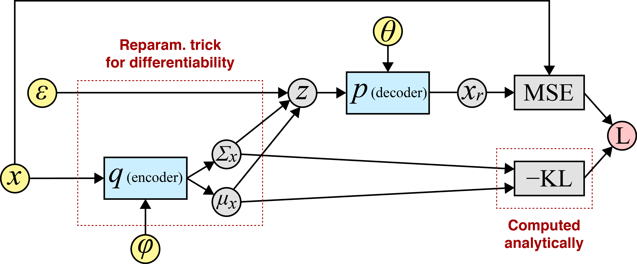
Reparameterization trick

Slide 9
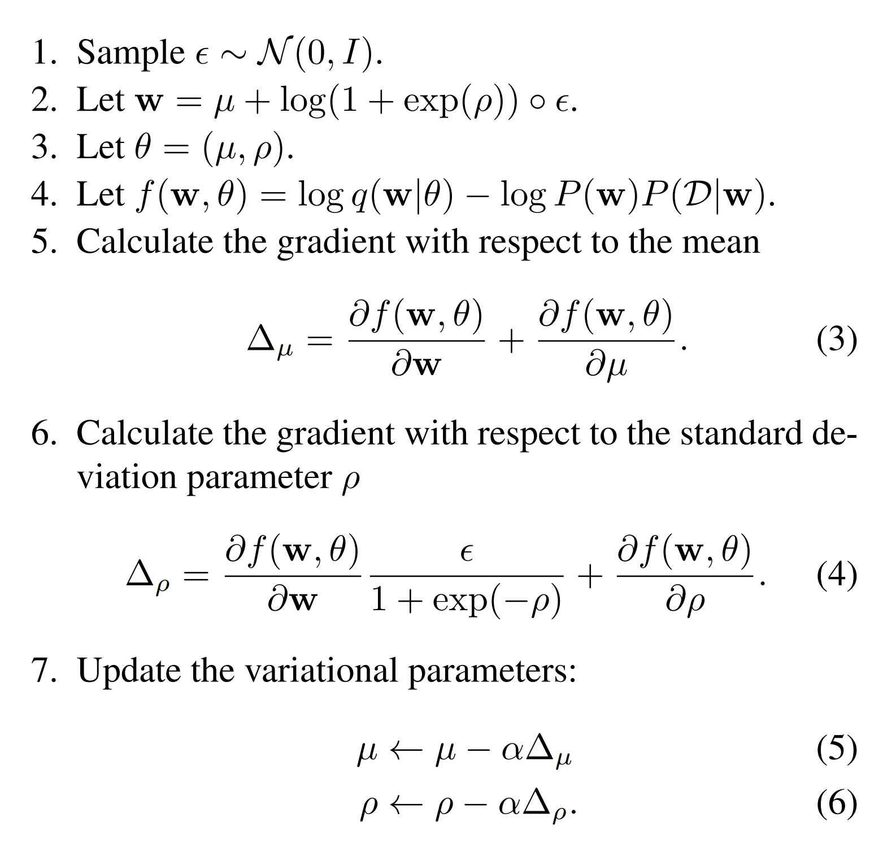
Train process

Slide 10
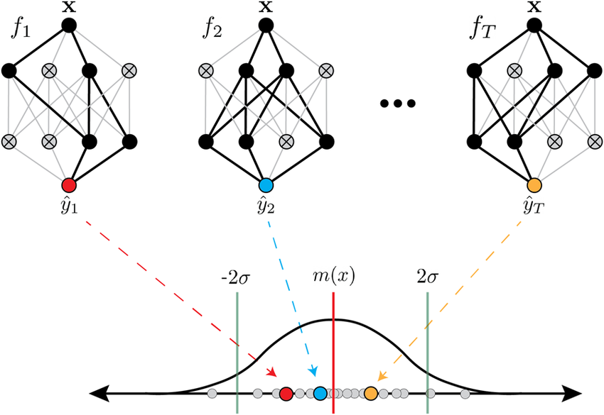
MC Dropout

Slide 11
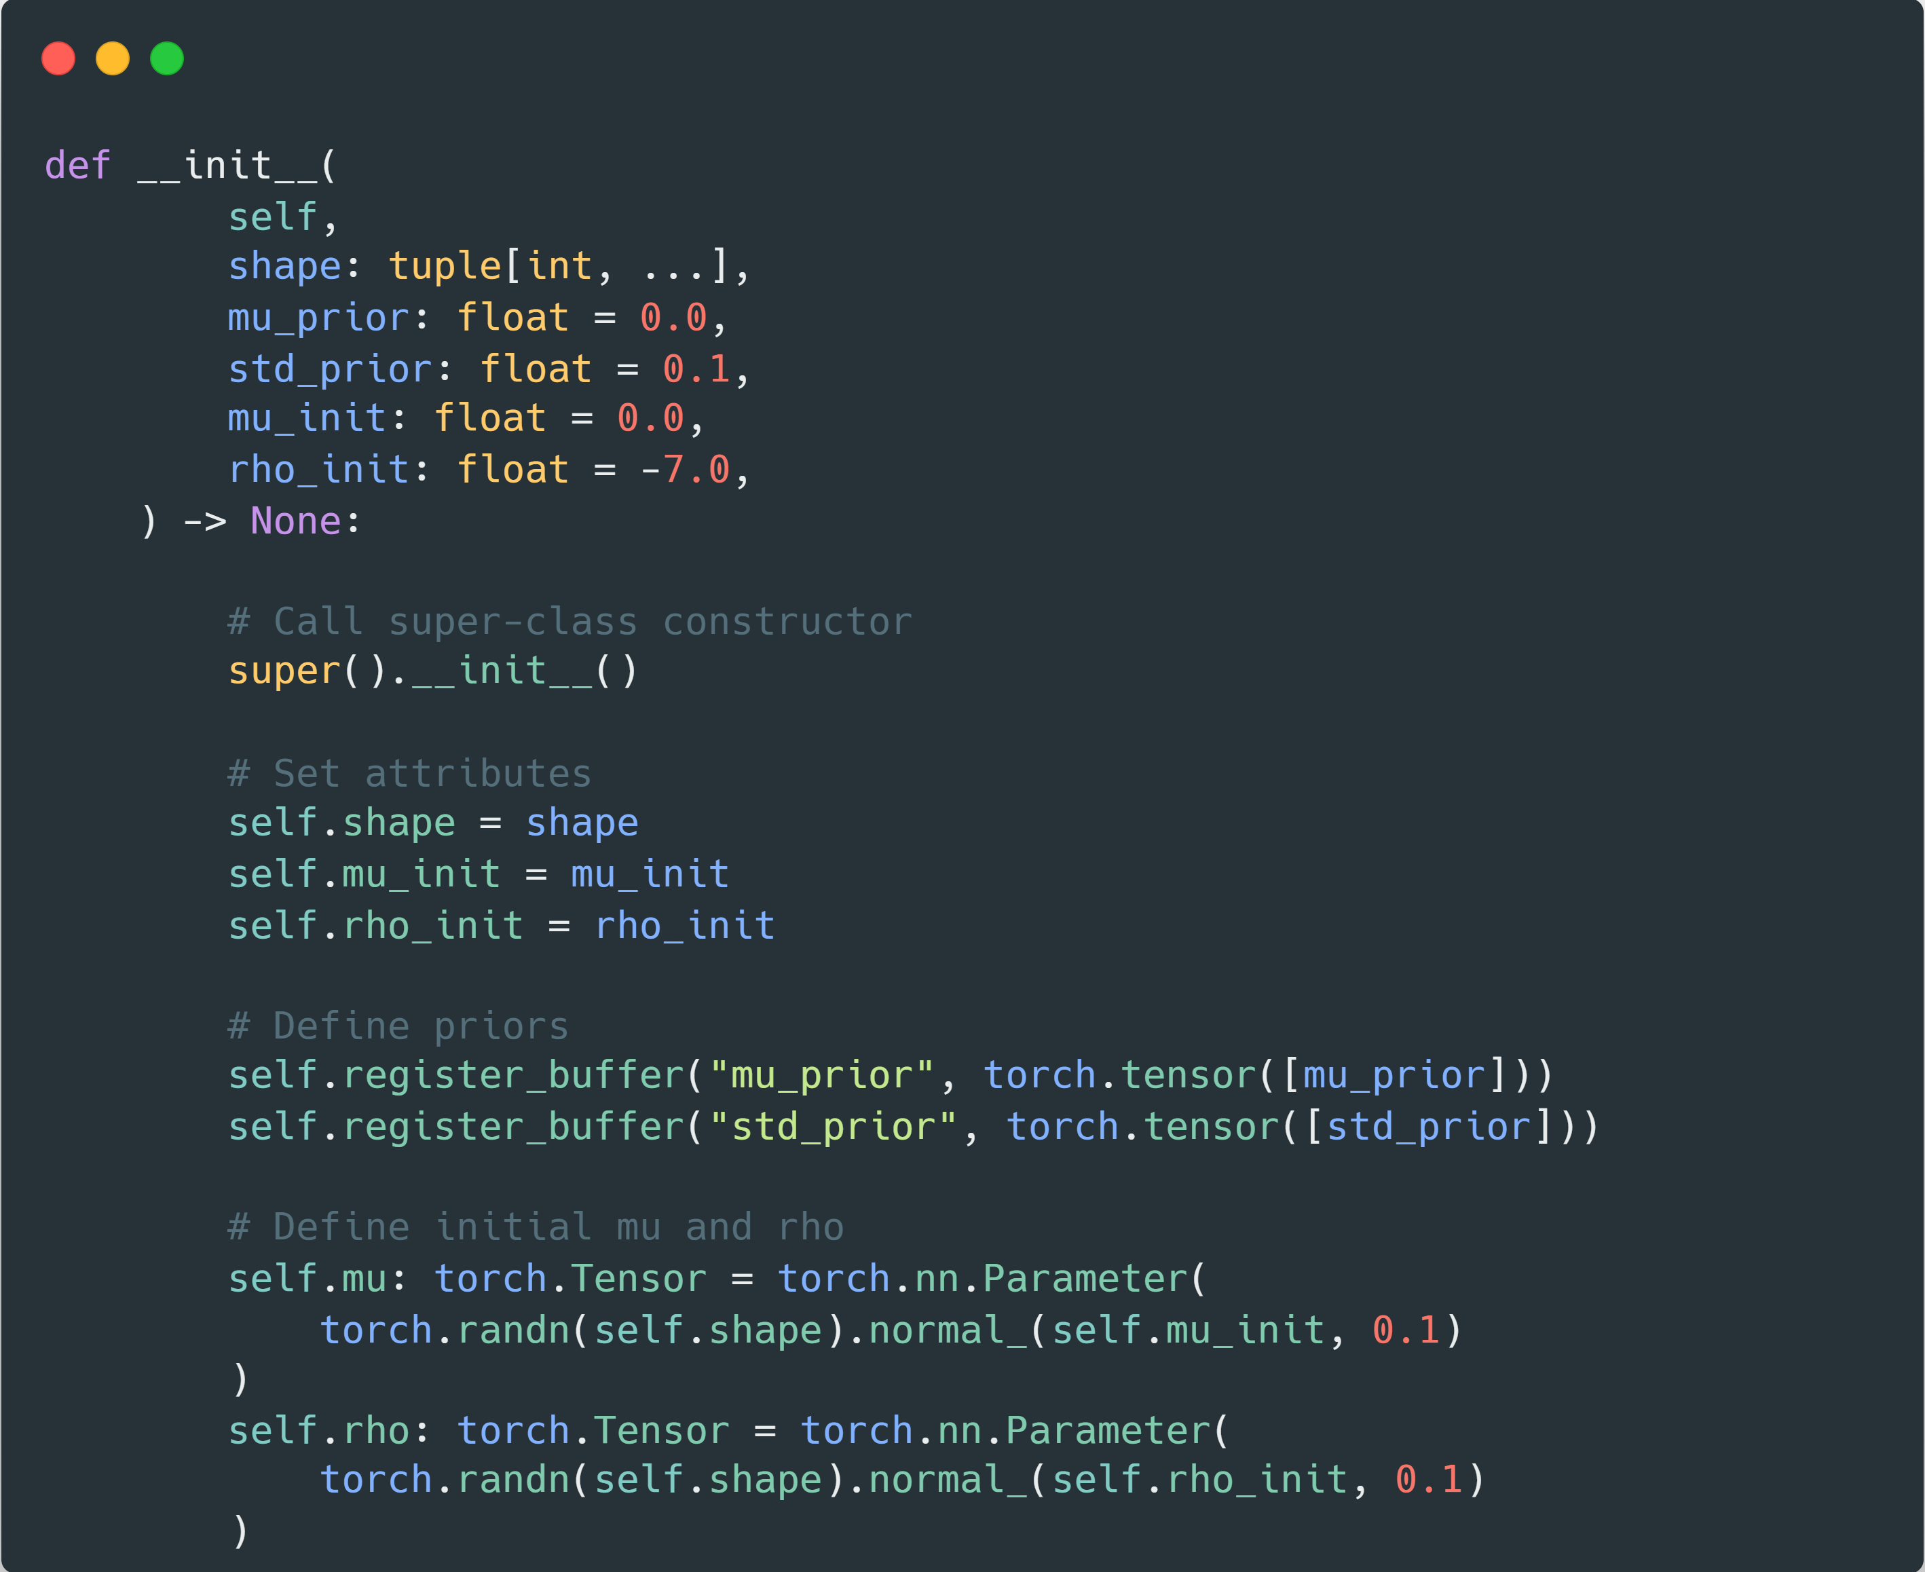
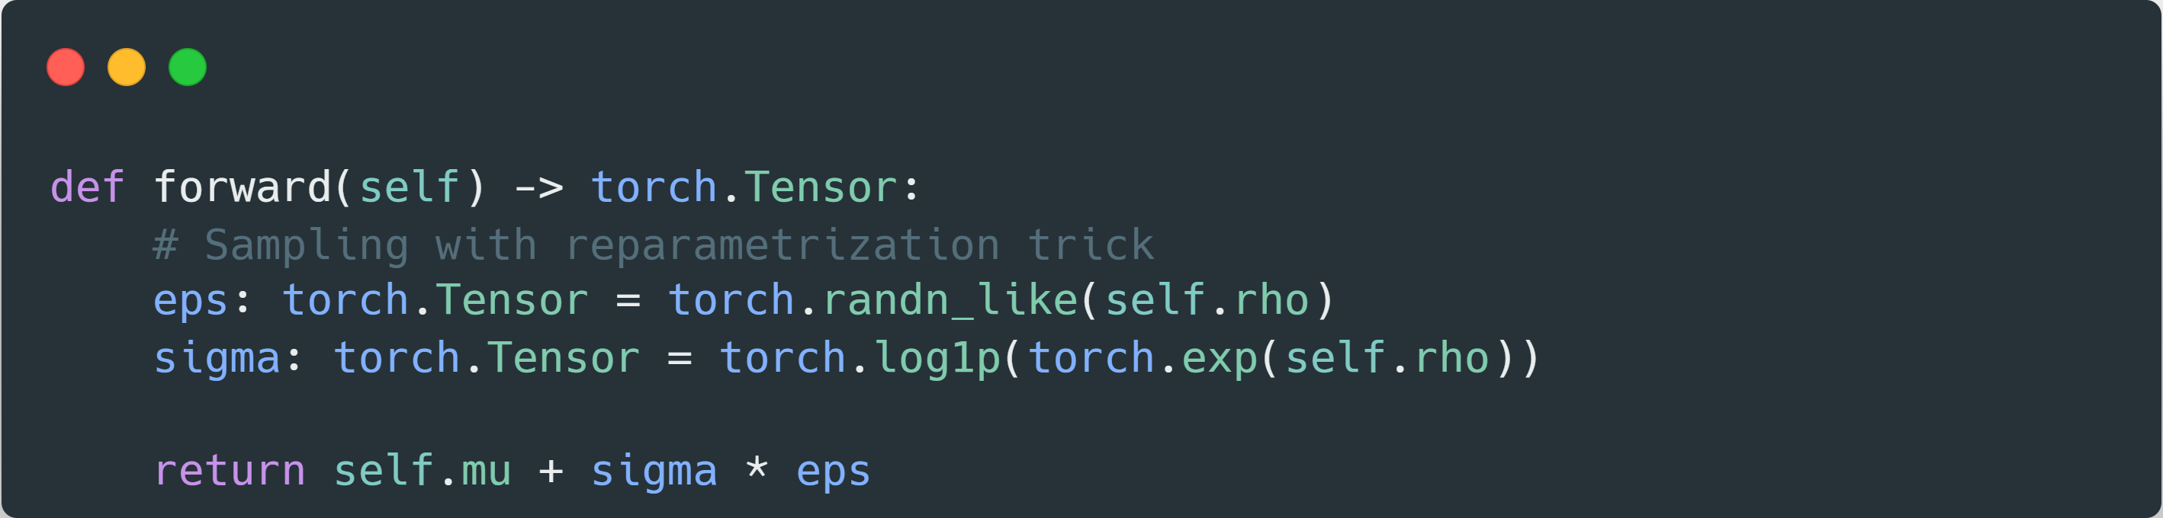
GaussianDistribution class

Slide 12
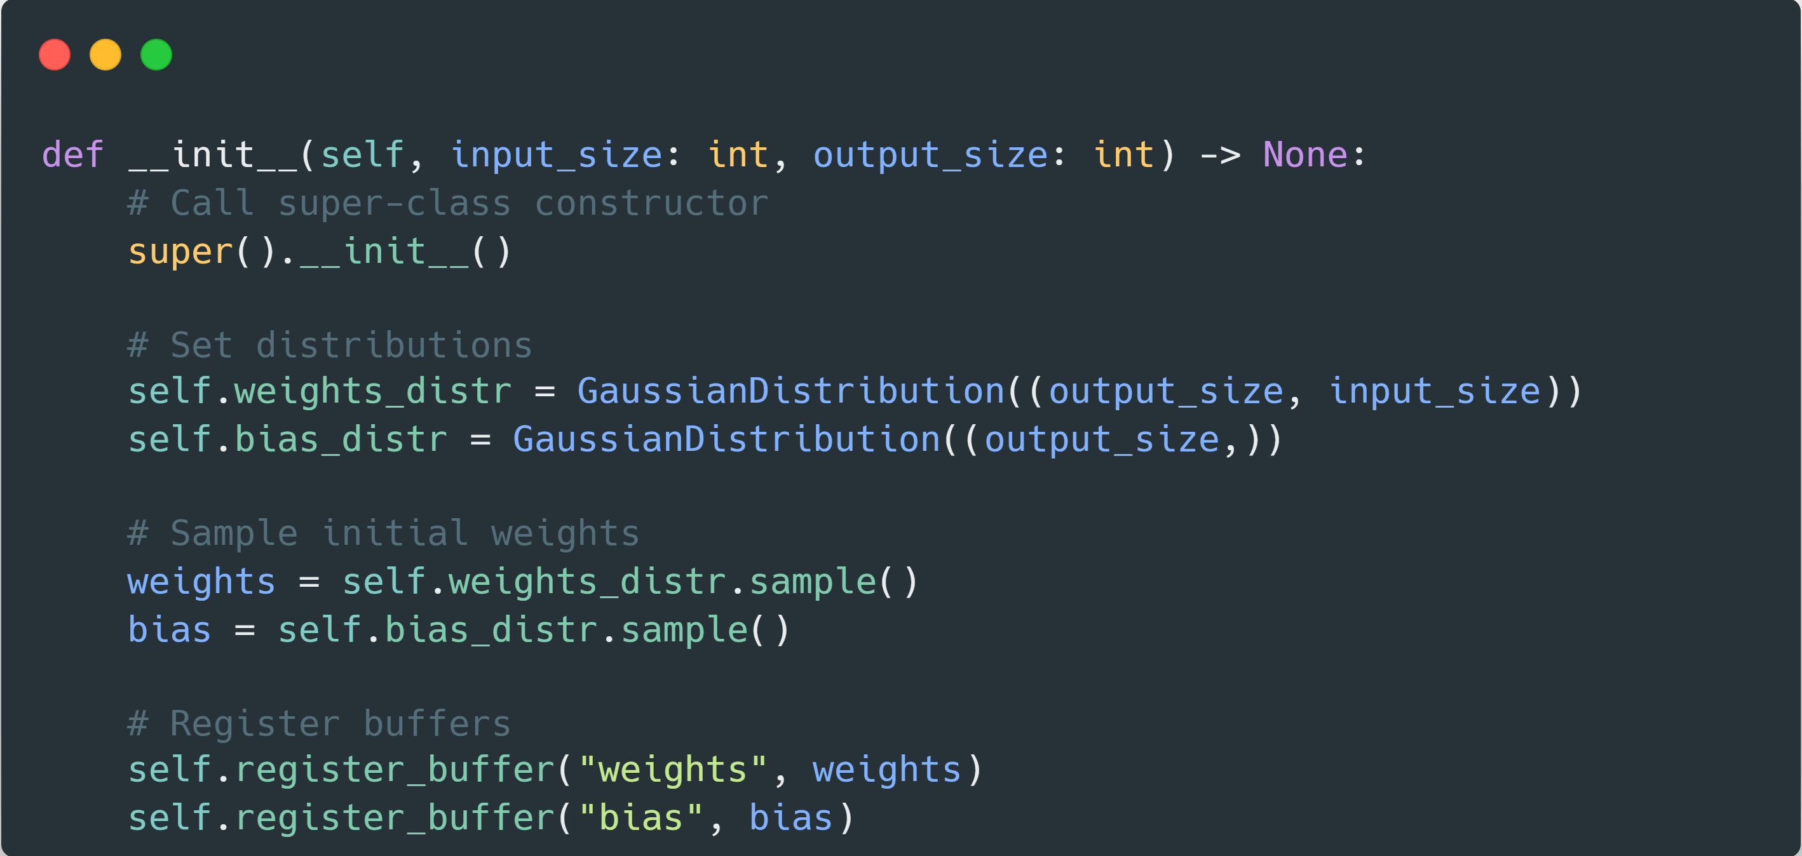
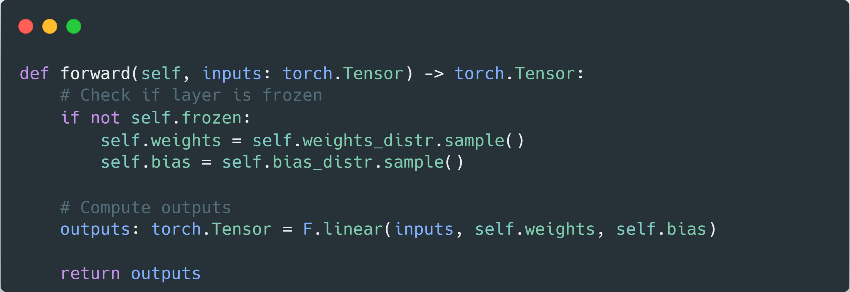
Bayesian Linear Layer

Slide 13
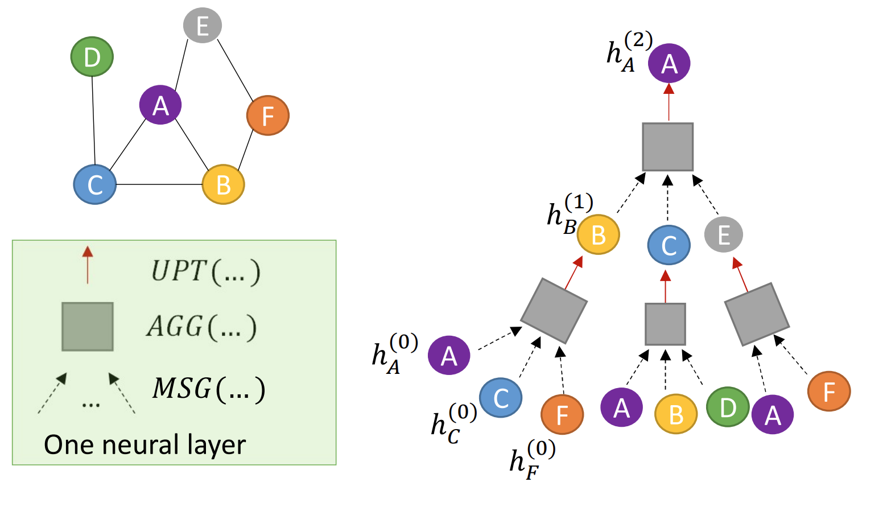
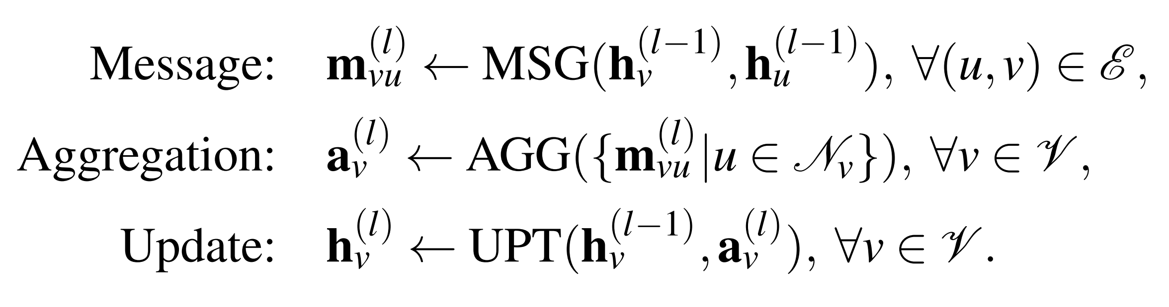
Message Passing

Slide 14
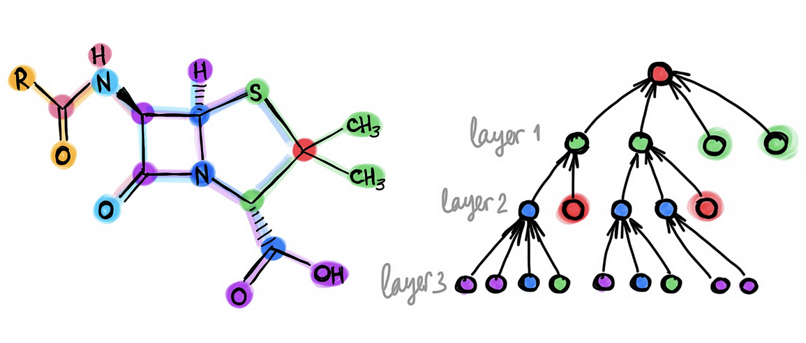
Graph Neural Networks + BNNs

Slide 15
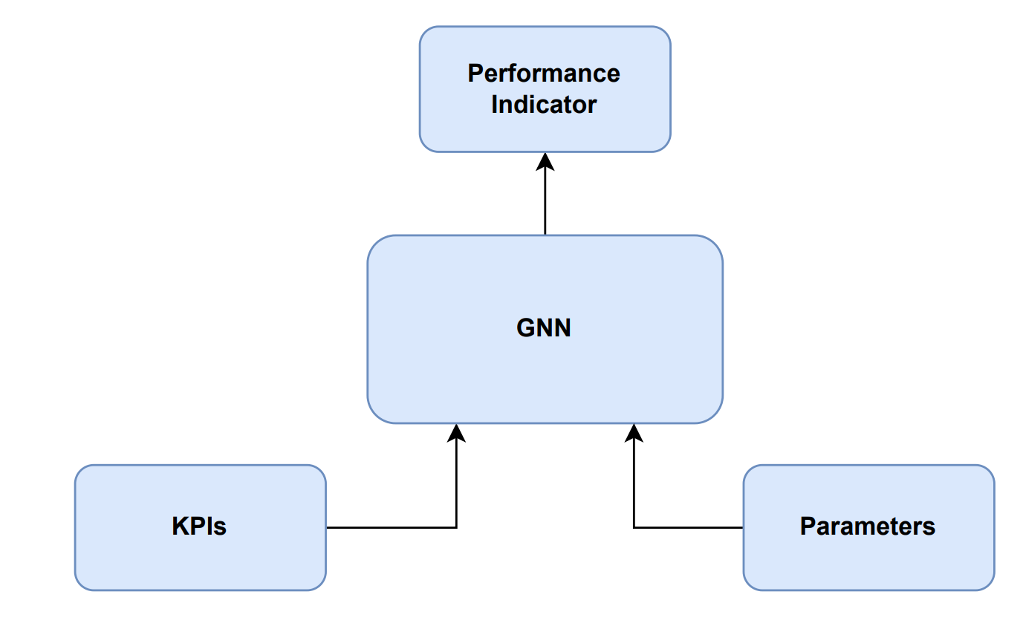

How to optimize a cellular network
Cellular Network
Solution Architecture
Optimization

Slide 16


Uplink Interference
Interference from neighbor cell
Serving eNB
Neighbor eNB
pZeroNominalPusch (p0)
Target uplink transmission power of UE
High p0 = high UE throughput, but also higher interference on neighbors
Alpha (a)
Pathloss compensation factor
High a = higher UE throughput at cell border, higher neighbor interference

Slide 17
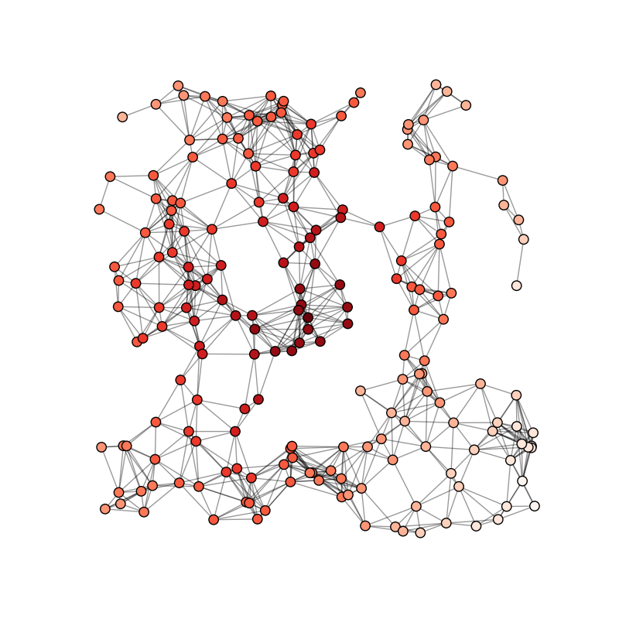
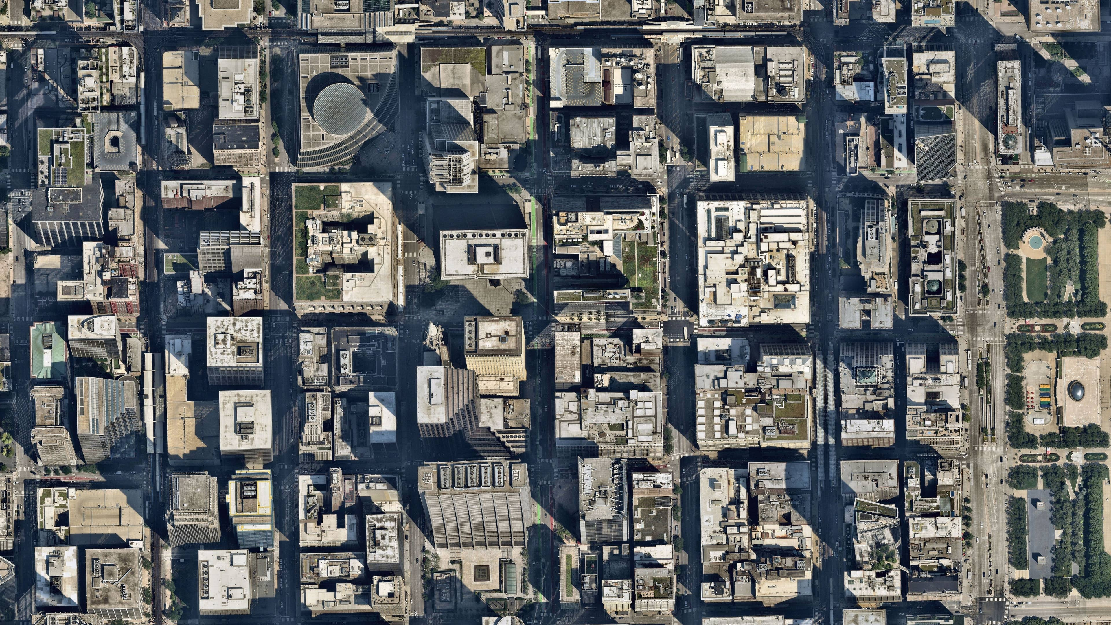
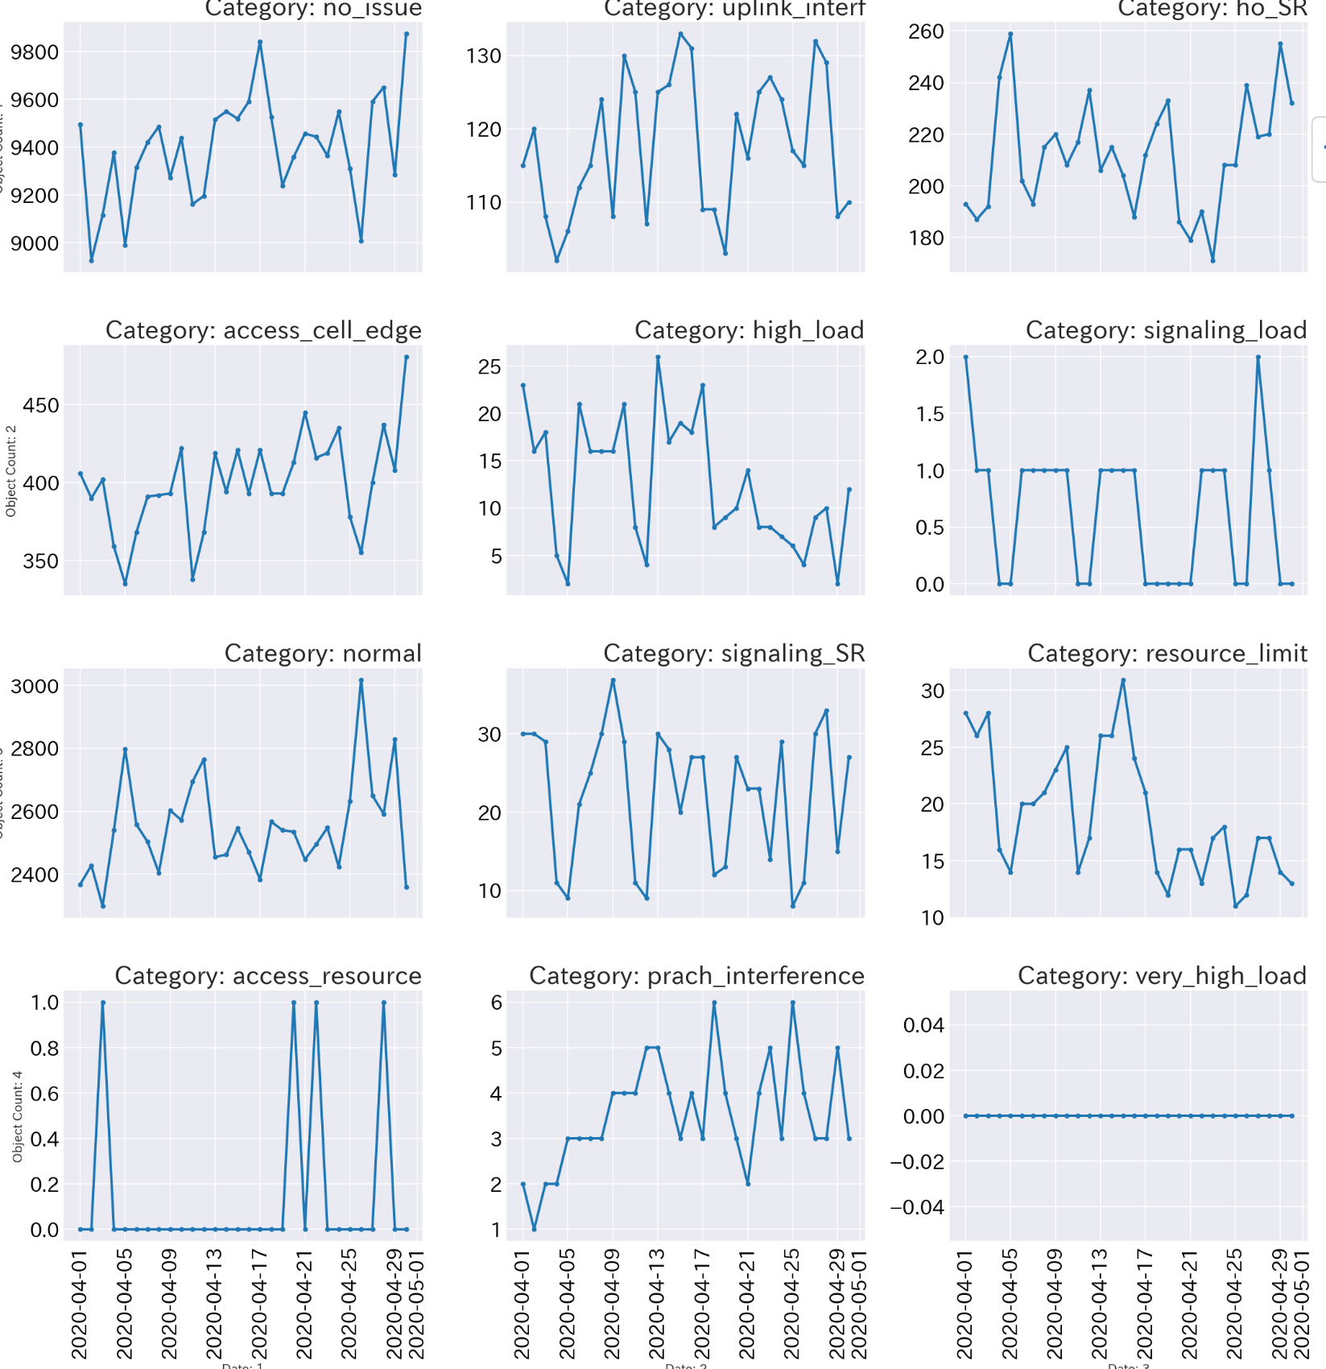
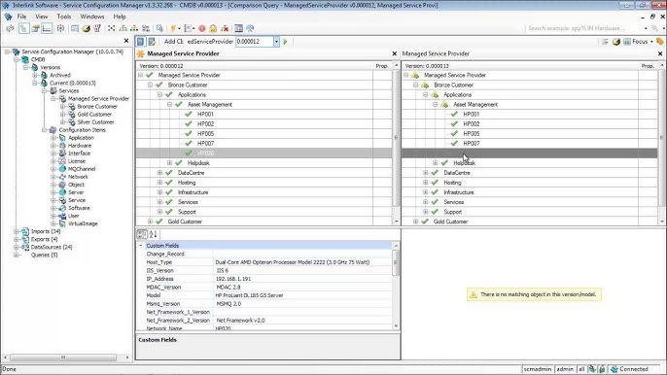


Digital Twin
Apply Graph Neural Network (GNN) to accurately model radio cellular network relations & configurations
Encode Network Data
Generic parameter framework to emulate effect on network performance indicator
Relation information:
- Physical distance
- Traffic exchanged
- Footprint overlap
- Relation parameters
Performance metrics
C
A
D
E
Configuration
F
B
Accurate modeling of real cellular network behavior
GNN architecture provides a native way of modelling cellular network interactions. The framework being developed will make the optimizer development process very straight forward and intuitive.
Digital Twin
GNN optimizer modelling enable the finding of the optimal configuration without the need of interacting with the live network by emulating radio network performance functionality from real network data

Slide 18
Test Configuration
Predicted UL SINR
(Including Performance KPIs)
1. Predict SINR with
current parameters
[-110, 8]
2. Predict SINR with
new parameters
20
[-90, 10]
18
13
[-106, 9]
[-92, 9]
Trained BGNN Model
10
15
16
Issue cell
[-80, 8]
17
[-120, 10]
17
Issue cell
[-100, 10]
21
[-103, 10]
8
1. Alter power parameters
20
[-88, 9]
2. Alter power parameters until
predicted SINR is maximized
14

Slide 19
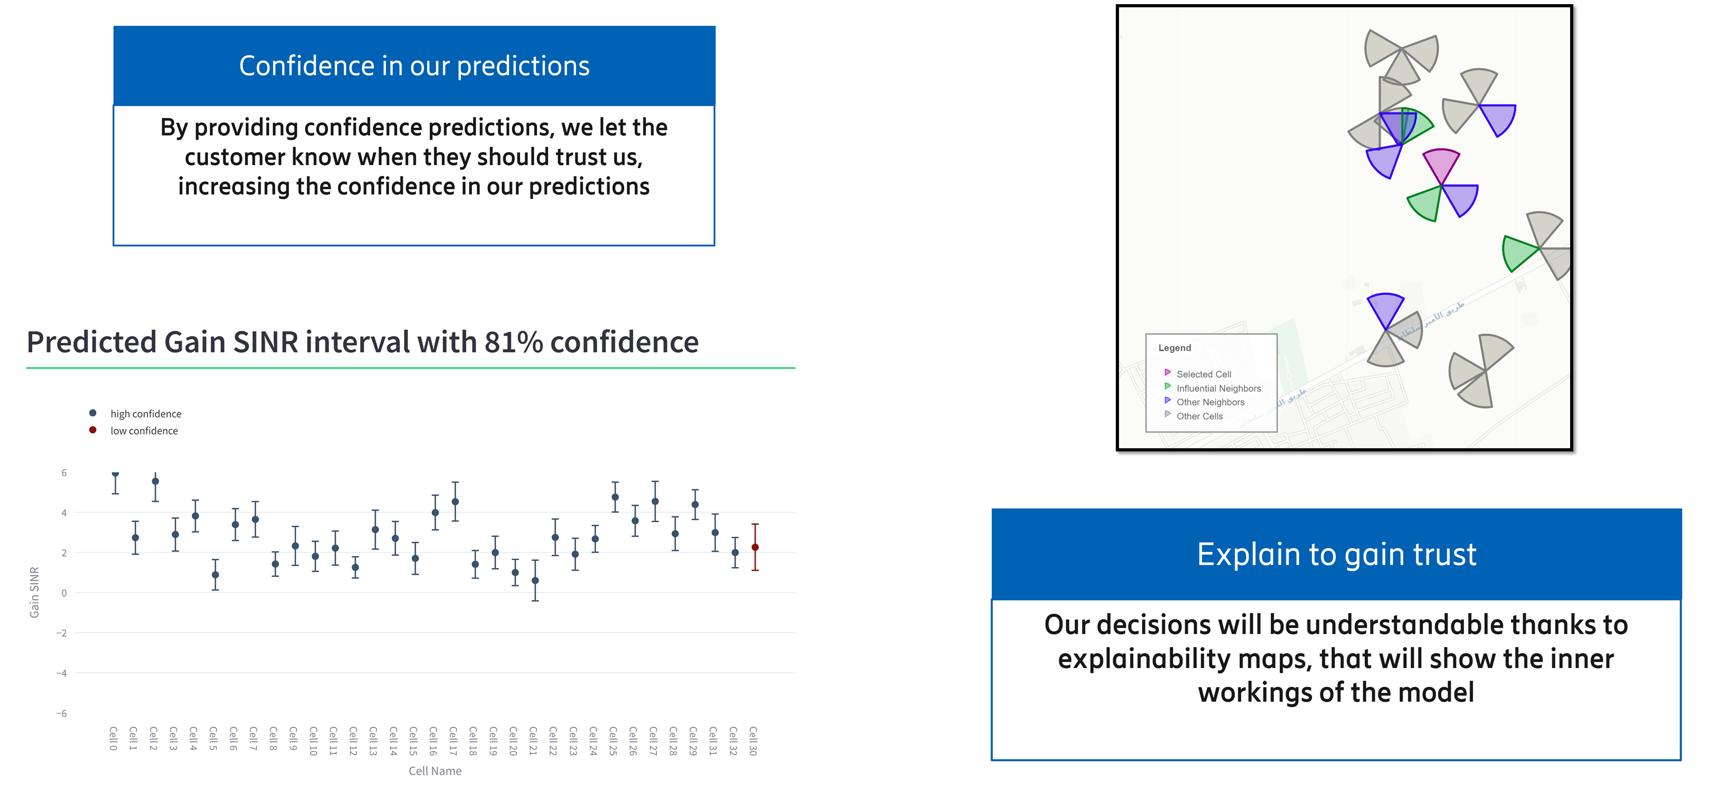
Real Production Results

Slide 20
References
Weight Uncertainty in Neural Networks
https://pytorch-geometric.readthedocs.io/en/latest/
https://graph-neural-networks.github.io/
https://medium.com/towards-data-science/do-we-need-deep-graph-neural-networks-be62d3ec5c59
Journal of Advances in Modeling Earth Systems

Slide 21



